Slide 1
UNIT 3 – Supervised Learning: Classification

Slide 2
Index
SUPERVISED LEARNING: CLASSIFICATION
Lazy learning:
Nearest neighbors,
Naïve Bayes,
Divide and Conquer:
Decision Trees and Rules
Support vector machine,
Evaluate Model Performance:
Accuracy, Logarithmic Loss, Area Under Curve, Precision,
Recall, F1 Score, Confusion Matrix

Slide 3
1. Lazy learning
Lazy learning is a fascinating approach in machine learning where the model delays generalization until it’s absolutely necessary — that is, until a query arrives.
Instead of building a predictive model during training, it simply stores the data and waits.
When a new input comes in, it computes the output based on the stored data.
Here, the model doesn’t learn any parameters — it just memorizes the data and uses it when needed.

Slide 4
🧠1.1 Lazy Learning example
✅ Great for small datasets
✅ No need to retrain when new data arrives
❌ Slower predictions on large datasets
❌ Sensitive to irrelevant features and noise
Aspect | Lazy Learning | Eager Learning
Training Time | Minimal (just stores data) | Significant (builds a model)
Prediction Time | High (computes on-the-fly) | Fast (uses pre-trained model)
Generalization | Deferred until query time | Done during training
Examples | k-Nearest Neighbors (k-NN) | Linear Regression, Decision Trees

Slide 5
🔎 1.2 Classification
Classification: predict categories Regression: predict numbers
Real-life examples:
Spam email detection → Spam (1) / Not Spam (0).
Medical test → Disease (1) / No Disease (0).
Bank loan → Default (1) / Repay (0).
We have labeled data (features → class).
The algorithm learns decision rules.
New data → model predicts class.

Slide 6
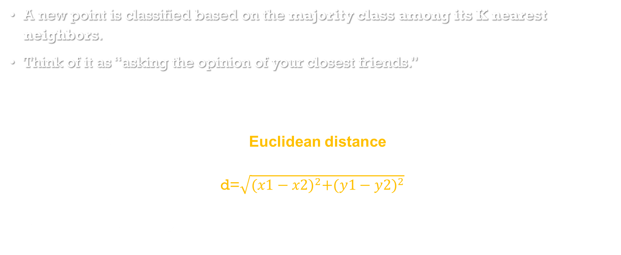
1.2.1 K-Nearest Neighbours (KNN)
A new point is classified based on the majority class among its K nearest neighbors.
Think of it as “asking the opinion of your closest friends.”
Look at the k closest neighbors in training data, the majority class among them is the prediction.
Distance between points (usually Euclidean distance):
d=$\sqrt{{(x1−x2)}^{2}+{(y1−y2)}^{2}}$
Choose k neighbors with smallest distance.

Slide 7
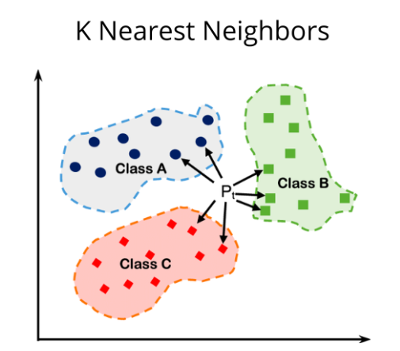
KNN contd…
Imagine you move into a new city and want to guess whether you’ll like a restaurant.
You ask your 3 nearest neighbors what they think (K=3).
If 2 say “Yes” and 1 says “No” → you predict “Yes.”
This is exactly what KNN does:
It stores the training data points.
To predict, it looks at the k closest points using distance formula.
Referencd: https://medium.com/@sachinsoni600517/k-nearest-neighbours-introduction-to-machine-learning-algorithms-9dbc9d9fb3b2

Slide 8
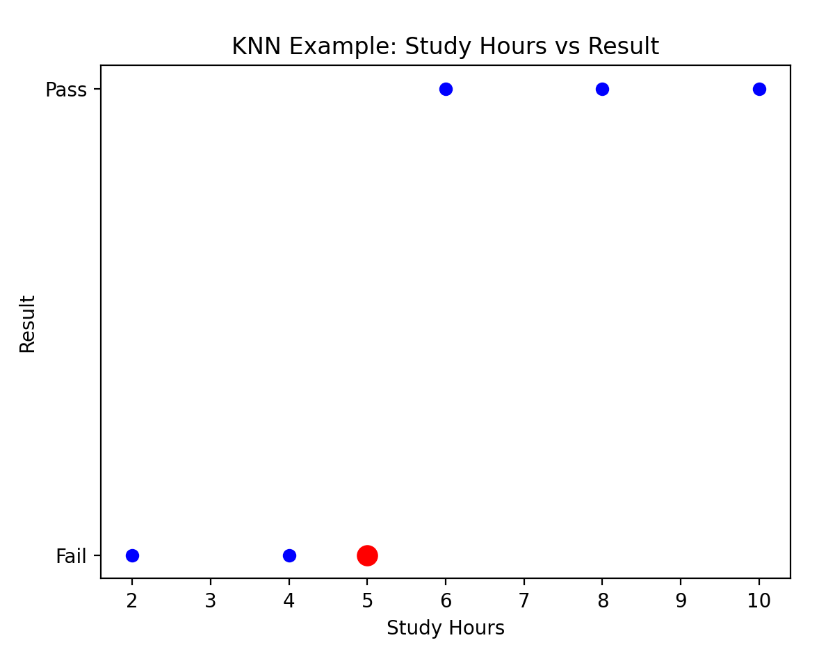
1.2.2 KNN concept
import numpy as np
import matplotlib.pyplot as plt
from sklearn.neighbors import KNeighborsClassifier# Tiny dataset
X = np.array([[2],[4],[6],[8],[10]]) # Hours studied
y = np.array([0,0,1,1,1]) # 0=Fail, 1=Pass# Train KNN
#Use the KNN classifier model with N=3
model = KNeighborsClassifier(n_neighbors=3)
model.fit(X,y)# Predict for new student
# Now use the new data for the prediction
new_student = np.array([[5]])
prediction = model.predict(new_student)
print("Prediction for 5 hours:", "Pass" if prediction[0]==1 else "Fail")
# Plot dataset + new point
plt.scatter(X, y, color="blue", label="Training Points")
plt.scatter(new_student, prediction, color="red", s=100, label="New Student (5 hrs)")
plt.yticks([0,1], ["Fail","Pass"])
plt.xlabel("Study Hours")
plt.ylabel("Result")
#plt.legend()
plt.title("KNN Example: Study Hours vs Result")
plt.show()

Slide 9
1.2.3 KNN with titanic DS to predict the survival prob.
import pandas as pd
import matplotlib.pyplot as plt
from sklearn.model_selection import train_test_split
from sklearn.neighbors import KNeighborsClassifier
# Load Titanic dataset
#url = "https://raw.githubusercontent.com/datasciencedojo/datasets/master/titanic.csv"
url="titanic.csv"
data = pd.read_csv(url)
# Select important features
# ensure that df is an independent copy of the selected columns, rather than a view
df = data[['Survived','Pclass','Sex','Age','Fare']].copy()
# Handle missing values
df['Age'] = df['Age'].fillna(df['Age'].median())
# Encode Sex: male=0, female=1
df['Sex'] = df['Sex'].map({'male':0, 'female':1})
# Features and target
X = df[['Pclass','Sex','Age','Fare']]
y = df['Survived']
# Train-test split
X_train,X_test,y_train,y_test = train_test_split(X,y,test_size=0.2,random_state=42)
# Train KNN
model = KNeighborsClassifier(n_neighbors=5)
model.fit(X_train, y_train)

Slide 10
# ---------------------------
# USER INPUT #
# ---------------------------
print("Enter passenger details:")
pclass = int(input("Pclass (1=Upper, 2=Middle, 3=Lower): "))
sex = int(input("Sex (0=Male, 1=Female): "))
age = float(input("Age: "))
fare = float(input("Fare: "))
#new_passenger = [[pclass, sex, age, fare]]
# Keep feature names
new_passenger = pd.DataFrame([[pclass, sex, age, fare]], columns=['Pclass','Sex','Age','Fare'])
# Prediction
prediction = model.predict(new_passenger)[0]
probability = model.predict_proba(new_passenger)[0][1] # survival probability
# Output
if prediction == 1:
print(f"Prediction: Survived (Probability: {probability:.2f})")
else:
print(f"Prediction: Did NOT Survive (Probability of survival: {probability:.2f})")

Slide 11
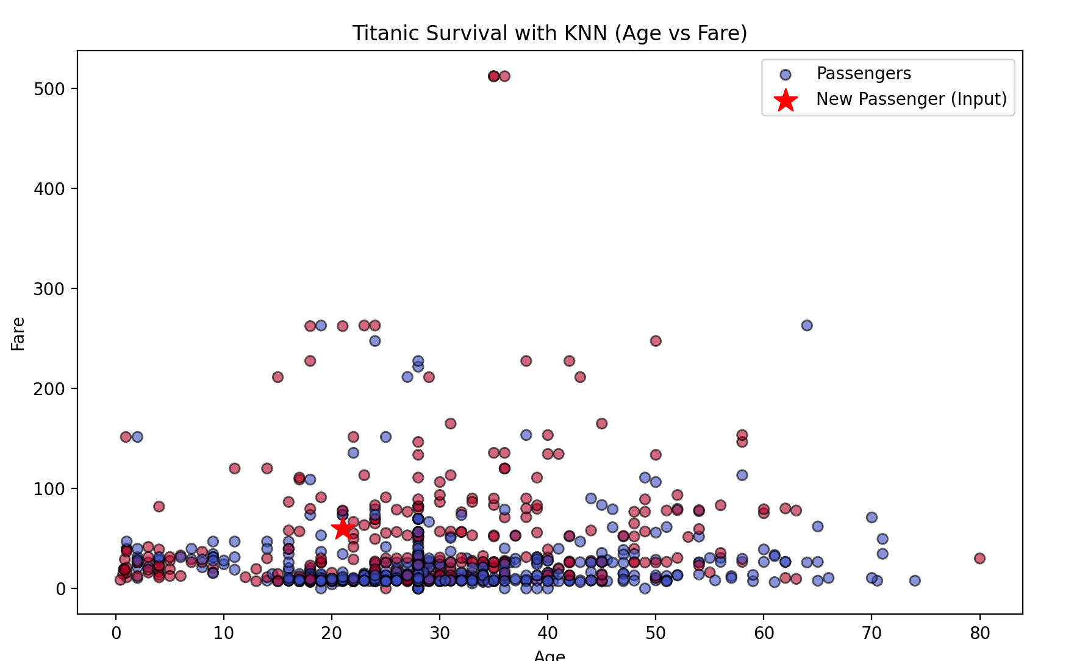
# --------------------------
# PLOT
# --------------------------
plt.figure(figsize=(10,6))
# Plot training data
plt.scatter(df['Age'], df['Fare'], c=df['Survived'], cmap="coolwarm", edgecolor="k", alpha=0.6, label="Passengers")
# Plot new passenger as a RED STAR
plt.scatter(age, fare, marker='*', c='red', s=200, label="New Passenger (Input)")
plt.xlabel("Age")
plt.ylabel("Fare")
plt.title("Titanic Survival with KNN (Age vs Fare)")
plt.legend()
plt.show()
Younger + higher fare passengers = more survivors (red cluster).
Older + lower fare passengers = fewer survivors (blue cluster).
KNN uses neighborhoods around a new point to decide survival.

Slide 12
🧠 Why We Split Data for KNN (Even Though It’s Lazy)
K-Nearest Neighbors (KNN) is indeed a lazy learner—it doesn’t build a model during training.
Instead, it memorizes the training data and makes predictions only at inference time by comparing new inputs to stored examples.

Slide 13
✅ Purpose of train_test_split in KNN
Even though KNN doesn’t “train” in the traditional sense, we still need to:
Separate known data (training) from unknown data (testing) to simulate real-world prediction.
Evaluate generalization: We want to know how well KNN performs on unseen data.
Avoid data leakage: If we test on the same data we used for training, we get misleadingly high accuracy.
Set | Role in KNN | What Happens
X_train | Stored examples | Used to compute distances during prediction
X_test | New inputs | Compared against X_train to find nearest neighbors
y_train | Known labels | Used to vote or average among neighbors
y_test | Ground truth | Used to evaluate prediction accuracy

Slide 14
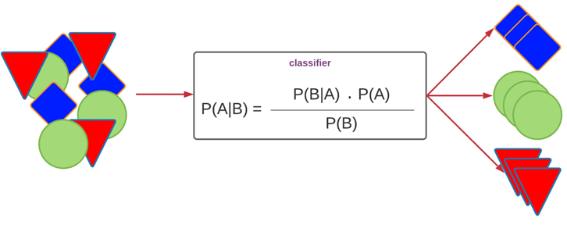
1.2.3 Naïve Bayes
Imagine you are a doctor. A patient walks in and you want to predict if they have a cold. You ask 3 simple questions:
Do they have a runny nose?
Do they have a sore throat?
Do they have a fever?
👉 If most answers suggest “cold,” you classify as cold. 👉 If not, you classify as no cold.
Naïve Bayes works exactly like this, it uses probabilities of different features to decide the class.

Slide 15
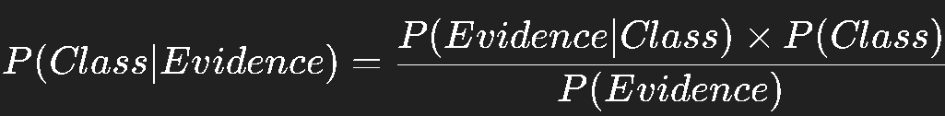
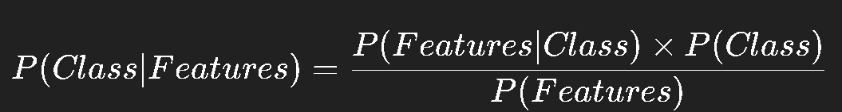
Bayes’ theorem (also known as the Bayes’ rule)
is a mathematical formula used to determine the conditional probability of events.
describes the probability of an event based on prior knowledge of the conditions that might be relevant to the event.
named after English statistician, Thomas Bayes, who discovered the formula in 1763.
It is considered the foundation of the special statistical inference approach called the Bayes’ inference.
Bayes’ theorem formula is: P(A|B) = P(B|A)*P(A)/P(B)
Source: https://mlarchive.com/machine-learning/the-ultimate-guide-to-naive-bayes/

Slide 16
🌱 “Naïve” mean !!
The Naive Bayes consists of two words:
Naive: As it assumes the independency between traits or features.
Bayes: Based on Bayes’ theorem.
To use the algorithm:
We must convert the presented data set into frequency tables.
Then create a probability table by finding the probabilities of certain features.
Then use Bayes’ theorem in order to calculate the posterior probability.
Bayes’ theorem formula is: P(A|B) = P(B|A)*P(A)/P(B)

Slide 17
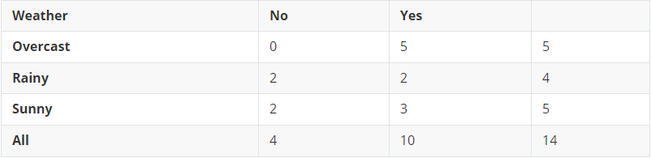
Example: Step 1: Count Totals
We want to predict whether people Play or Not Play based on the Outlook (Sunny, Rainy, Overcast).
The given Dataset
Index | Outlook | Play
0 | Rainy | Yes
1 | Sunny | Yes
2 | Overcast | Yes
3 | Overcast | Yes
4 | Sunny | No
5 | Rainy | Yes
6 | Sunny | Yes
7 | Overcast | Yes
8 | Rainy | No
9 | Sunny | No
10 | Sunny | Yes
11 | Rainy | No
12 | Overcast | Yes
13 | Overcast | Yes
From the table: Total rows = 14
Play = Yes → 10 times Play = No → 4 times
So, the prior probabilities are:
P(Yes)=9/14, P(No)=5/14P
Convert The Dataset to Frequency table.

Slide 18
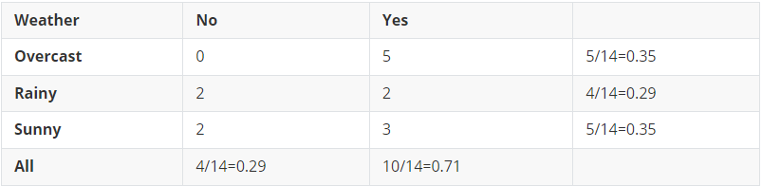
Step 2: Conditional Probabilities
Now we calculate likelihoods: e.g.
When Outlook = Sunny, how often do we Play = Yes vs No?
From the table: Sunny appears 5 times (indices 1, 4, 6, 9, 10).
Out of these, Play=Yes → 3 times Play=No → 2 times
So:
P(Sunny∣Yes)=3/5, P(Sunny∣No)=2/5
Similarly: Rainy: (Yes=2, No=2) Overcast: (Yes=4, No=0)
Index | Outlook | Play
0 | Rainy | Yes
1 | Sunny | Yes
2 | Overcast | Yes
3 | Overcast | Yes
4 | Sunny | No
5 | Rainy | Yes
6 | Sunny | Yes
7 | Overcast | Yes
8 | Rainy | No
9 | Sunny | No
10 | Sunny | Yes
11 | Rainy | No
12 | Overcast | Yes
13 | Overcast | Yes
Likelihood/probability table

Slide 19
calculation
Bayes’ theorem formula is: P(A|B) = P(B|A)*P(A)/P(B)
A = class (e.g., Play=Yes or Play=No) B = evidence (e.g., Outlook=Sunny)
we can skip P(B) (denominator) : Notice that both formulas have the same denominator: P(Sunny) Since we’re only comparing which class has the higher probability, we don’t need to compute P(Sunny)P(Sunny)P(Sunny).
👉 We only need to compare the numerators. The denominator is the same for both, so it doesn’t change which class is bigger.

Slide 20
Step 3: Prediction Example
Bayes’ theorem formula is: P(A|B) = P(B|A)*P(A)/P(B)
👉 Suppose Outlook = Sunny. Should we predict Play=Yes or No?
Using Bayes’ Rule:
P(Yes∣Sunny)∝P(Sunny∣Yes)×P(Yes) P(No∣Sunny)∝P(Sunny∣No)×P(No)
Substitute values:
P(Yes∣Sunny)∝(3/9)×(9/14)=27/126 P(No∣Sunny)∝(2/5)×(5/14)=10/70=18/126
So: P(Yes∣Sunny)>P(No∣Sunny)
✅ Prediction: Yes (Play tennis) when it’s Sunny.

Slide 21
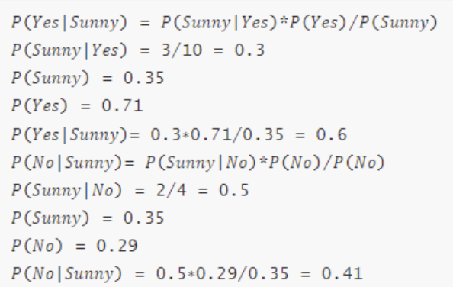
Step 4: Intuition
Naïve Bayes is counting frequencies and then using probability to guess the outcome.
It doesn’t look at complicated math, just how common patterns are in the data.
That’s why it works surprisingly well, even with simple assumptions.

Slide 22
🌱 implementation
Naïve Bayes is a probability-based classifier that applies Bayes’ theorem:
P(Class ∣ Features) = P(Features ∣ Class) × P(Class) / P(Features)
Class = e.g., Survived / Not Survived
Features = e.g., Age, Fare, Gender
It predicts the class with the highest posterior probability.
The “Naïve” part = assumes all features are independent (which is often not true, but surprisingly works well).

Slide 23
Naïve Bayes has multiple versions depending on the data type of the features:
MultinomialNB → word counts (text classification), If features are categorical counts
BernoulliNB → binary features (spam = yes/no), If features are binary
GaussianNB → continuous features like Age, Fare, Height, Weight, If features are continuous
👉 Titanic has continuous values (Age, Fare), so we use GaussianNB.

Slide 24
Play or not : based on weather outlook
import pandas as pd
from sklearn.naive_bayes import CategoricalNB
from sklearn.preprocessing import LabelEncoder
# Dataset
data = pd.DataFrame({
'Outlook': ['Rainy','Sunny','Overcast','Overcast','Sunny',
'Rainy','Sunny','Overcast','Rainy','Sunny',
'Sunny','Rainy','Overcast','Overcast'],
'Play': ['Yes','Yes','Yes','Yes','No',
'Yes','Yes','Yes','No','No',
'Yes','No','Yes','Yes']
})
# Encode categorical data
le_outlook = LabelEncoder()
le_play = LabelEncoder()
data['Outlook_enc'] = le_outlook.fit_transform(data['Outlook'])
data['Play_enc'] = le_play.fit_transform(data['Play'])
le = LabelEncoder()
outlook = ['Rainy', 'Sunny', 'Overcast', 'Sunny', 'Rainy’]
encoded = le.fit_transform(outlook)
print("Original:", outlook)
print("Encoded :", encoded)
print("Classes :", le.classes_)
'''
Original: ['Rainy', 'Sunny', 'Overcast', 'Sunny', 'Rainy’]
Encoded : [1 2 0 2 1]
Classes : ['Overcast' 'Rainy' 'Sunny']
'''

Slide 25
X = data[['Outlook_enc']]
y = data['Play_enc']
# Train Naive Bayes
model = CategoricalNB()
model.fit(X, y)
# Predict for Sunny
new_outlook = pd.DataFrame({'Outlook_enc':[le_outlook.transform(['Sunny'])]})
pred = model.predict(new_outlook)[0]
print("Prediction for Outlook=Sunny:", le_play.inverse_transform([pred]))
-> If the feature is categorical but not ordinal (no natural order), sometimes using OneHotEncoder is safer, because ML models might think Sunny=2 > Rainy=1.
-> Use inverse_transform() to convert numbers back to labels:
decoded = le.inverse_transform(encoded)
print("Decoded:", decoded)
# Decoded: ['Rainy' 'Sunny' 'Overcast' 'Sunny' 'Rainy']

Slide 26
Titanic Dataset code example- GaussianNB
import pandas as pd
from sklearn.model_selection import train_test_split
from sklearn.naive_bayes import GaussianNB
from sklearn.metrics import accuracy_score, confusion_matrix, ConfusionMatrixDisplay
import matplotlib.pyplot as plt
# Load Titanic dataset
#url = "https://raw.githubusercontent.com/datasciencedojo/datasets/master/titanic.csv"
url="titanic.csv"
data = pd.read_csv(url)
# Select features
df = data[['Survived','Pclass','Sex','Age','Fare']].copy()
df['Age'] = df['Age'].fillna(df['Age'].median())
df['Sex'] = df['Sex'].map({'male':0, 'female':1})
X = df[['Pclass','Sex','Age','Fare']]
y = df['Survived']
# Train-test split
X_train,X_test,y_train,y_test = train_test_split(X,y,test_size=0.2,random_state=42)
# Train Naive Bayes
model = GaussianNB()
model.fit(X_train,y_train)
continuous features like Age, Fare, Height, Weight, If features are continuous

Slide 27
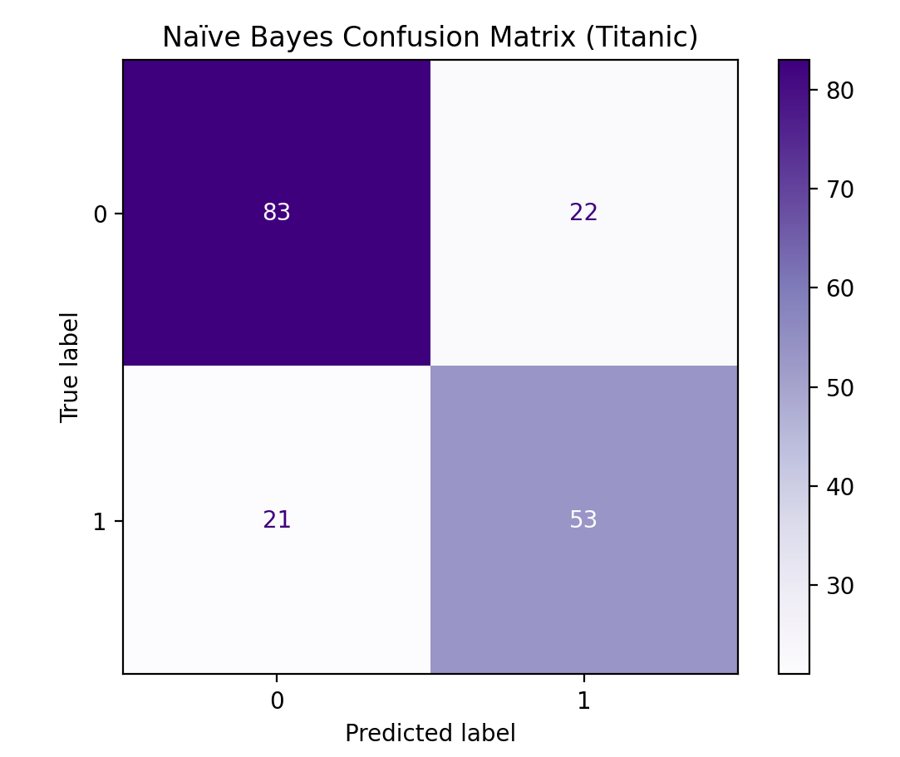
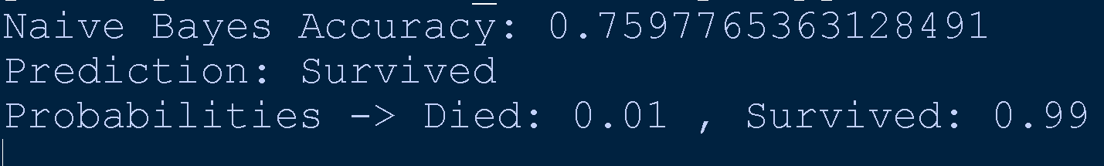
# Predict
y_pred = model.predict(X_test)
print("Naive Bayes Accuracy:", accuracy_score(y_test,y_pred))
# Confusion matrix
cm = confusion_matrix(y_test, y_pred, labels=model.classes_)
disp = ConfusionMatrixDisplay(confusion_matrix=cm, display_labels=model.classes_)
disp.plot(cmap="Purples")
plt.title("Naïve Bayes Confusion Matrix (Titanic)")
plt.show()
# Try a new passenger
new_passenger = pd.DataFrame([[1,1,25,100]], columns=['Pclass','Sex','Age','Fare'])
prediction = model.predict(new_passenger)[0]
prob = model.predict_proba(new_passenger)[0]
print("Prediction:", "Survived " if prediction==1 else "Not Survived ")
print("Probabilities -> Died:", round(prob[0],2), ", Survived:", round(prob[1],2))
returns a NumPy array of predictions.
[0] just takes out the first element

Slide 28
Example (Titanic):
Suppose a passenger is:
Female
1st class
Age = 25
Fare = 100
Naïve Bayes asks:
What’s the probability a female in 1st class survived?
What’s the probability a female in 1st class did not survive?
Whichever is higher → that’s the prediction.

Slide 29
Inside GaussianNB()
Step 1: Compute Priors - It counts how many samples belong to each class:
Example (Titanic): P(Survived=1) = 342/891 P(Survived=0) = 549/891
Step 2: Compute Feature Distributions (per class) - For each feature (Age, Fare, etc.) and for each class (Survived=0 or 1), it assumes the values follow a Gaussian (Normal) Distribution: P(x∣Class)= 1/ sqrt( 2πσ²)​ * ​pow (e, - (x−μ)^{2​} / 2σ²)
where: μ= mean of feature values for that class, σ^2 = variance of feature values for that class,
x = observed feature value
Step 3: Multiply Probabilities - Since it assumes independence, it multiplies probabilities for each feature: P(Class∣Age,Fare) ∝ P(Age∣Class) × P(Fare∣Class) × P(Class)
Step 4: Pick the Highest Probability
Finally, it compares posterior probabilities for each class and picks the larger one:
👉 If P(Survived=1∣X)>P(Survived=0∣X) predict Survived.

Slide 30
Confusion Matrix
A table that shows how well a classification model performed by comparing:
True Labels (actual values)
Predicted Labels (what the model guessed)
It breaks predictions into 4 categories:
Term | Meaning | Example (Titanic)
True Positive (TP) | Model predicted Survived (1) and the passenger actually Survived | Correct survivor
True Negative (TN) | Model predicted Not Survived (0) and passenger actually Not Survived | Correct non-survivor
False Positive (FP) | Model predicted Survived (1) but passenger actually Not Survived | Wrongly predicted survival
False Negative (FN) | Model predicted Not Survived (0) but passenger actually Survived | Missed a survivor

Slide 31
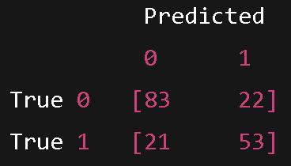
Confusion Matrix
TN = 83 →
83 passengers correctly predicted as Not Survived.
TP = 53 →
53 passengers correctly predicted as Survived.
FP = 22 →
22 passengers wrongly predicted as Survived when they didn’t.
FN = 21 →
21 passengers wrongly predicted as Not Survived when they actually did survive.
The diagonal numbers (83, 53) are the correct predictions.
The off-diagonal numbers (22, 21) are the mistakes.
More dark color on diagonal = better model.

Slide 32
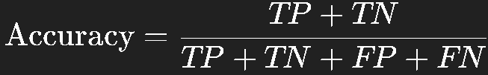
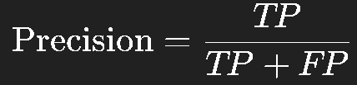
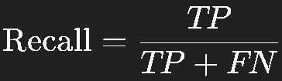
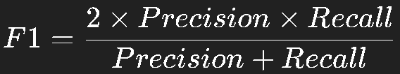
Metrics from this Matrix
Accuracy
Accuracy=(TP+TN)/ (TP+TN+FP+FN) =(83+53) /(83+22+21+53) =136/179 ≈0.76
👉 So the model is about 76% accurate.
Precision (for Survived = 1)
Precision=TP/ (TP+FP) =53/(53+22) =53/75 ≈0.71
👉 Out of all predicted survivors, 71% were correct.
Recall (Sensitivity)
Recall=TP/ (TP+FN) =53/ (53+21)= 53/74 ≈0.72
👉 The model correctly identified 72% of real survivors.
F1 Score (balance of Precision & Recall)
F1= (2×Precision×Recall)/ (Precision+Recall) ≈0.71

Slide 33
✅ KNN vs Naïve Bayes
KNN → decision based on similarity (neighbors).
GaussianNB → decision based on probability distribution (math).

Slide 34
1.2.4🌱 Divide and Conquer: Decision Trees and Rules
A decision tree is a supervised learning algorithm used for classification and regression.
It splits the dataset into branches based on feature thresholds, aiming to create pure subsets (where most samples belong to one class).
A Decision Tree does the same → it splits the dataset step by step into smaller groups until it can make a decision.
Each split (branch) is based on a condition (rule).
Final outcome is a leaf node (e.g., "Survived" or "Not Survived").

Slide 35
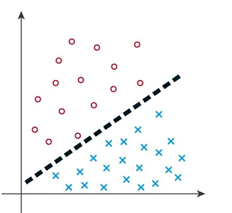
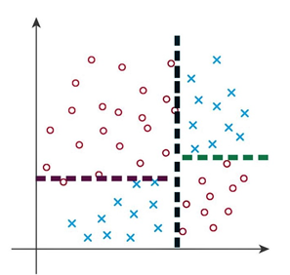
Decision Tree
It’s rare for data to be perfectly linearly separable.
Often, a single line cannot separate the classes effectively.
This is where decision trees come in.
By asking a series of questions, a decision tree divides the data in a way that allows us to separate non-linear datasets.
The process follows a path through the tree, effectively handling more complex data distributions, as shown in the image below.
Source: https://blog.gopenai.com/decision-trees-a-deep-dive-into-making-smarter-decisions-b0be706513af

Slide 36
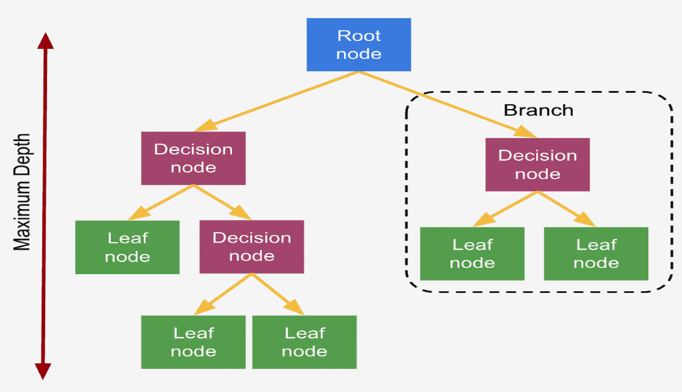
🧠 Structure of a Decision Tree
Root Node: The starting point, representing the entire dataset.
Internal Nodes: Decision points based on feature values.
Branches: Outcomes of decisions (e.g., "Yes" or "No").
Leaf Nodes: Final output (class label or predicted value).

Slide 37
Advantages vs Limitations
✅ Advantages
Easy to interpret and visualize
Handles both numerical and categorical data
Requires little preprocessing
⚠️ Limitations
Prone to overfitting
Can be unstable with small data changes

Slide 38
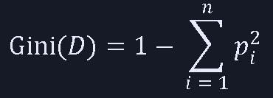
Sample Dataset: Play Tennis
ID | Outlook | Wind | PlayTennis
1 | Sunny | Weak | No
2 | Sunny | Strong | No
3 | Overcast | Weak | Yes
4 | Rain | Weak | Yes
5 | Rain | Strong | No
6 | Overcast | Strong | Yes
We’ll build a decision tree using Gini impurity (how the splits are chosen.) to decide the best feature to split on.
Gini impurity measures how often a randomly chosen element would be incorrectly labeled if it were randomly labeled according to the distribution of labels in the subset.
Were, 𝑝𝑖 is the proportion of class 𝑖 in the dataset 𝐷.
Gini = 0 → Pure node (all samples same class)
Gini close to 0.5 → Mixed classes
We’ll build a decision tree using Gini impurity to decide the best feature to split on.

Slide 39
🔍 Step 1: Gini of the Root Node
ID | Outlook | Wind | PlayTennis
1 | Sunny | Weak | No
2 | Sunny | Strong | No
3 | Overcast | Weak | Yes
4 | Rain | Weak | Yes
5 | Rain | Strong | No
6 | Overcast | Strong | Yes
We have 6 samples: Yes: 3 No: 3
Gini_{root}=1−(3/6)²−(3/6)²=1−0.25−0.25=0.5
Total Gini of node
= weighted average Gini impurity of the Leave
=((Total number of yes / Total population)* Gini impurity of Yes )
+ ((Total number of No's / Total population)*(Gini impurity of No))
🔍 Step 2.1: Try Splitting on “Outlook”
Split by Outlook: Sunny → [No, No] Overcast → [Yes, Yes] Rain → [Yes, No]
🌞 Sunny (2 No): Gini_{Sunny} =1−(1)²−(0)² =0
☁️ Overcast (2 Yes): Gini_{Overcast} =1−(1)²−(0)² =0
🌧️ Rain (1 Yes, 1 No): Gini_{Rain} =1−(1/2)²−(1/2)²=1−0.25−0.25 =0.5
Weighted Gini After Split: Gini_{Outlook} = 2/6*0 + 2/6*0 + 2/6*0.5 = 0.167
Gini Gain: Gain_{Outlook} =Gini_{root}−Gini_{Outlook} =0.5−0.167 =0.333

Slide 40
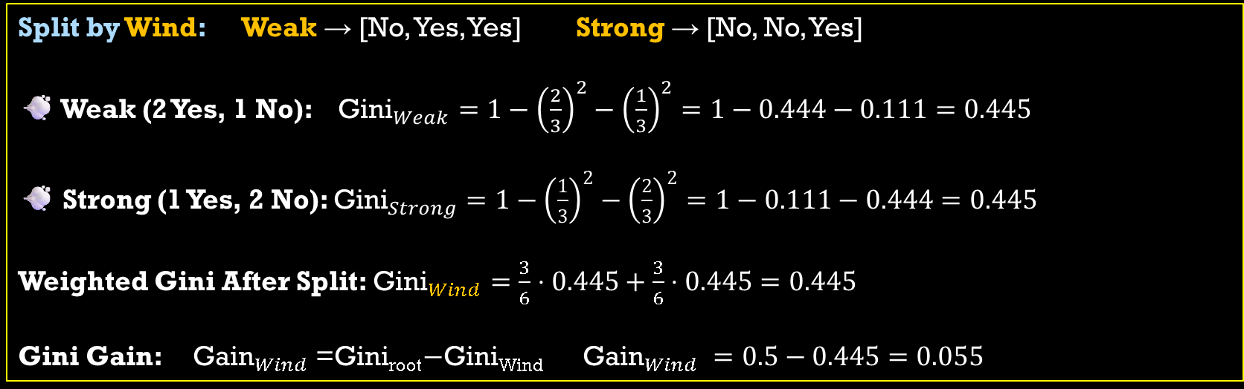
🔍 Step 2.2: Try Splitting on “Wind”
Split by Wind: Weak → [No, Yes, Yes] Strong → [No, No, Yes]
💨 Weak (2 Yes, 1 No): ${\text{Gini}}_{Weak}=1−{\left(\frac{2}{3}\right)}^{2}−{\left(\frac{1}{3}\right)}^{2}=1−0.444−0.111=0.445$
💨 Strong (1 Yes, 2 No): ${\text{Gini}}_{Strong}=1−{\left(\frac{1}{3}\right)}^{2}−{\left(\frac{2}{3}\right)}^{2}=1−0.111−0.444=0.445$
Weighted Gini After Split: ${\text{Gini}}_{Wind}=\frac{3}{6}⋅0.445+\frac{3}{6}⋅0.445=0.445$
Gini Gain: ${\text{Gain}}_{Wind}$=Gini_{root}−Gini_{Wind} ${\text{Gain}}_{Wind} =0.5−0.445=0.055$
ID | Outlook | Wind | PlayTennis
1 | Sunny | Weak | No
2 | Sunny | Strong | No
3 | Overcast | Weak | Yes
4 | Rain | Weak | Yes
5 | Rain | Strong | No
6 | Overcast | Strong | Yes
✅ Best Split: Outlook (Gain = 0.333) among 0.333 & 0.055
So the decision tree will first split on Outlook, because it gives the highest reduction in impurity.

Slide 41
🌳 Final Tree (Partial)
Outlook
Yes No
Sunny
Yes No
Overcast
Yes No
Rain
Yes No

Slide 42
Python implementaion
import pandas as pd
#🧪 Step 1: Prepare the Data
# Sample dataset
data = pd.DataFrame({
'Outlook': ['Sunny', 'Sunny', 'Overcast', 'Rain', 'Rain', 'Overcast'],
'Wind': ['Weak', 'Strong', 'Weak', 'Weak', 'Strong', 'Strong'],
'PlayTennis': ['No', 'No', 'Yes', 'Yes', 'No', 'Yes']
})
#🔄 Step 2: Encode Categorical Variables
from sklearn.preprocessing import LabelEncoder
# Encode features
le_outlook = LabelEncoder()
le_wind = LabelEncoder()
le_target = LabelEncoder()
data['Outlook_enc'] = le_outlook.fit_transform(data['Outlook'])
data['Wind_enc'] = le_wind.fit_transform(data['Wind'])
data['Target'] = le_target.fit_transform(data['PlayTennis'])
# Features and target
X = data[['Outlook_enc', 'Wind_enc']]
y = data['Target']

Slide 43
# 🌳 Step 3: Train the Decision Tree
from sklearn.tree import DecisionTreeClassifier
# Create and train model
clf = DecisionTreeClassifier(criterion='gini', max_depth=3, random_state=42)
clf.fit(X, y)
# 🎨 Step 4: Visualize the Tree
from sklearn.tree import plot_tree
import matplotlib.pyplot as plt
plt.figure(figsize=(8, 5))
plot_tree(clf,
feature_names=['Outlook', 'Wind'],
class_names=le_target.classes_,
filled=True)
plt.show()
# 🔍 Step 5: Make Predictions
# Predict for a new sample: Outlook=Rain, Wind=Weak
sample = [[le_outlook.transform(['Rain'])[0], le_wind.transform(['Weak'])[0]]]
sample = pd.DataFrame(sample, columns=['Outlook_enc', 'Wind_enc'])
pred = clf.predict(sample)
print("Prediction:", le_target.inverse_transform(pred)[0])

Slide 44
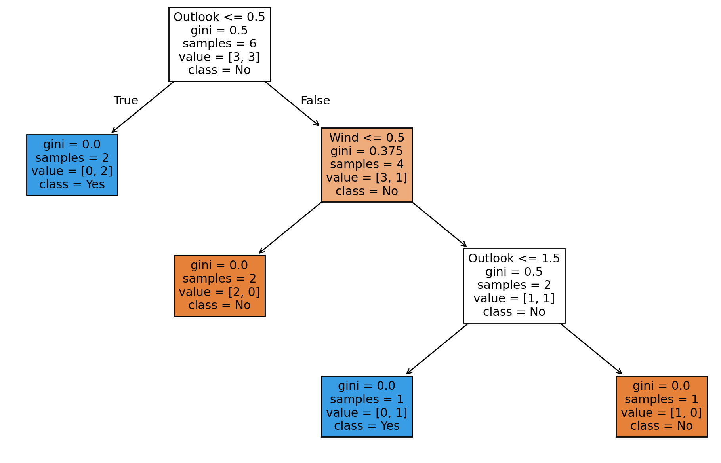

Because it's a tie, it defaults to class = No
Outlook <= 0.5
Since Outlook is label-encoded, the actual meaning depends on how LabelEncoder mapped the categories:
For example: Overcast = 0, Rain = 1, Sunny = 2 → so Outlook <= 0.5 means Overcast only.
gini = 0.5
This is the Gini impurity of the node.
samples = 6
Number of training samples that reached this node.
value = [3, 3]
This shows the class distribution at the nod
ID | Outlook | Wind | Play
1 | Sunny | Weak | No
2 | Sunny | Strong | No
3 | Overcast | Weak | Yes
4 | Rain | Weak | Yes
5 | Rain | Strong | No
6 | Overcast | Strong | Yes

Slide 45
🧮 Step 1: Label Encoding (Alphabetical)
Outlook | Encoded
Overcast | 0
Rain | 1
Sunny | 2
Wind | Encoded
Strong | 0
Weak | 1
PlayTennis | Encoded
No | 0
Yes | 1
📊 Step 2: Encoded Table
ID | Outlook | Wind | PlayTennis
1 | Sunny | Weak | No
2 | Sunny | Strong | No
3 | Overcast | Weak | Yes
4 | Rain | Weak | Yes
5 | Rain | Strong | No
6 | Overcast | Strong | Yes
ID | Outlook | Wind | PlayTennis
1 | 2 | 1 | 0
2 | 2 | 0 | 0
3 | 0 | 1 | 1
4 | 1 | 1 | 1
5 | 1 | 0 | 0
6 | 0 | 0 | 1

Slide 46
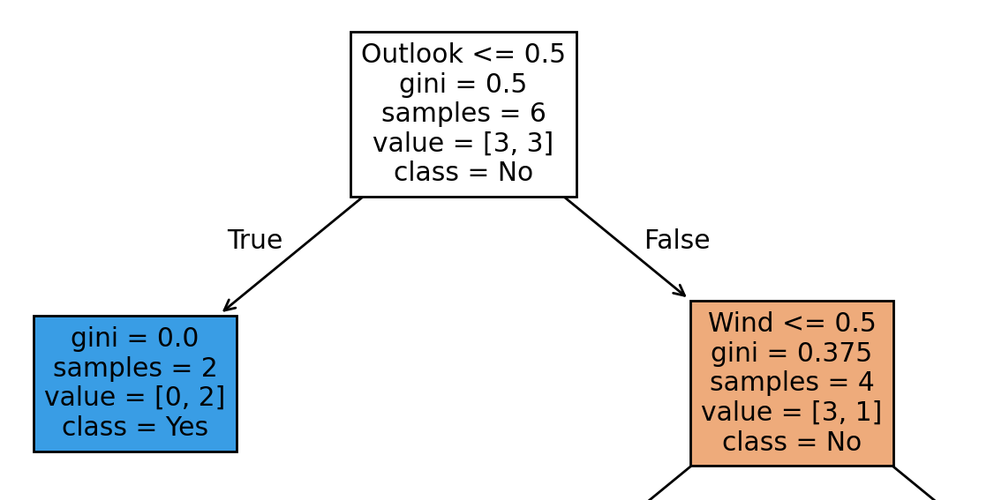
🌳 Step 3: Decision Tree Splitting
Outlook ≤ 0.5 : means only rows where Outlook == 0 (i.e., Overcast) go to the left branch.
Both entries have: PlayTennis = Yes → pure node
So, prediction for this branch is Yes
🌲 Right Branch (Outlook > 0.5):
Now the tree might split again, say on Wind ≤ 0.5
Out of 4 samples, 3 are labeled "No", 1 is "Yes“
So the model predicts "No" for any new sample that lands here; Even though there's some impurity (not all samples agree), the majority wins.
ID | Outlook | Wind | PlayTennis
1 | 2 | 1 | 0
2 | 2 | 0 | 0
3 | 0 | 1 | 1
4 | 1 | 1 | 1
5 | 1 | 0 | 0
6 | 0 | 0 | 1

Slide 47
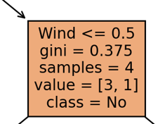
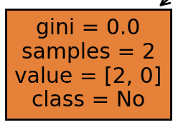
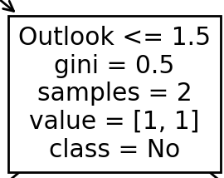
➡️ Right Branch (Outlook > 0.5) && Wind ≤ 0.5 (Strong): (But 6 is already in the left branch — so here we only consider 2 and 5)
Both are PlayTennis = No → pure node → prediction: No
ID | Outlook | Wind | PlayTennis
1 | 2 | 1 | 0
2 | 2 | 0 | 0
3 | 0 | 1 | 1
4 | 1 | 1 | 1
5 | 1 | 0 | 0
6 | 0 | 0 | 1
ID | Outlook | Wind | PlayTennis
1 | Sunny (2) | Weak (1) | No (0)
2 | Sunny (2) | Strong (0) | No (0)
4 | Rain (1) | Weak (1) | Yes (1)
5 | Rain (1) | Strong (0) | No (0)

Slide 48
ADDON

Slide 49
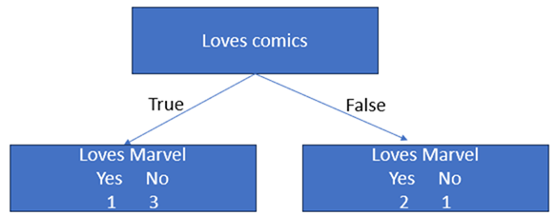
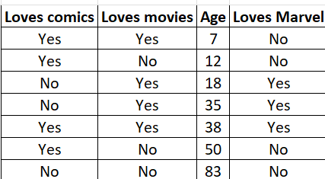
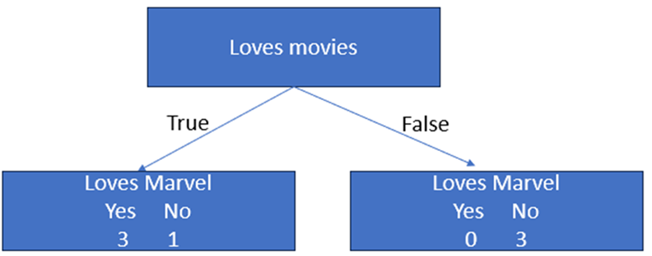
How Does a Decision Tree Make Splits
To decide, we need to first look at 1 feature, Loves comics and see how well it predicts if a person will love Marvel or not.
Likewise, we do the same step for other features, keeping track of whether or not each one loves Marvel or not.
The leaves where both yes/no decisions are present for Loves Marvel are called Impure nodes.
The node where loves movies is False, only No is present for Loves Marvel is called Pure Node.

Slide 50
There are several ways to quantify the impurity of a node.
Some famous methods used includes, gini impurity, entropy and information gain.
Gini impurity of a leaf = 1-(Probability of “yes”)² - (Probability of “no”)²
Gini impurity of Loves comics(Yes)
= 1–(1/4)²-(3/4)² = 0.375
Gini impurity of Loves comics(No)
= 1–(2/3)²-(1/3)² = 0.444
Total Gini impurity of Loves comics = weighted average Gini impurity of the Leave
=( (Total number of yes / Total population)* Gini impurity of Yes )
+ ((Total number of No’s / Total population)*(Gini impurity of No))
= ( (4/7) * 0.375 ) - ( (3/7) * 0.444 )
= 0.405

Slide 51
Titanic dataset example
import pandas as pd
from sklearn.tree import DecisionTreeClassifier, plot_tree
from sklearn.model_selection import train_test_split
from sklearn.metrics import accuracy_score
import matplotlib.pyplot as plt
# 📥 Load Titanic dataset
url = "https://raw.githubusercontent.com/datasciencedojo/datasets/master/titanic.csv"
df = pd.read_csv(url)
# 🧼 Preprocess
df['Sex'] = df['Sex'].map({'male': 0, 'female': 1})
df['Age'] = df['Age'].fillna(df['Age'].median())
# 🎯 Features and target
X = df[['Pclass', 'Sex', 'Age']]
y = df['Survived']
# 🧪 Train-test split
X_train, X_test, y_train, y_test = train_test_split(X, y, test_size=0.2, random_state=42)
# 🌳 Train Decision Tree
tree = DecisionTreeClassifier(max_depth=3, random_state=42)
tree.fit(X_train, y_train)

Slide 52
# 📊 Evaluate
y_pred = tree.predict(X_test)
print(f"\nModel Accuracy on Test Set: {accuracy_score(y_test, y_pred):.2f}")
# 🎨 Plot tree
plt.figure(figsize=(12, 6))
plot_tree(tree, feature_names=['Pclass', 'Sex', 'Age'], class_names=['Not Survived', 'Survived'], filled=True)
plt.show()

Slide 53
# 🧠 Command-line prediction
print("\n🔍 Predict Survival")
try:
pclass = int(input("Enter Pclass (1, 2, or 3): "))
sex = input("Enter Sex (male/female): ").strip().lower()
age = float(input("Enter Age: "))
sex_encoded = 0 if sex == 'male' else 1
sample = pd.DataFrame([[pclass, sex_encoded, age]], columns=['Pclass', 'Sex', 'Age'])
prediction = tree.predict(sample)[0]
result = "Survived" if prediction == 1 else "Not Survived"
print(f"\n🧾 Prediction: {result}")
except Exception as e:
print(f"\n⚠️ Error: {e}")

Slide 54
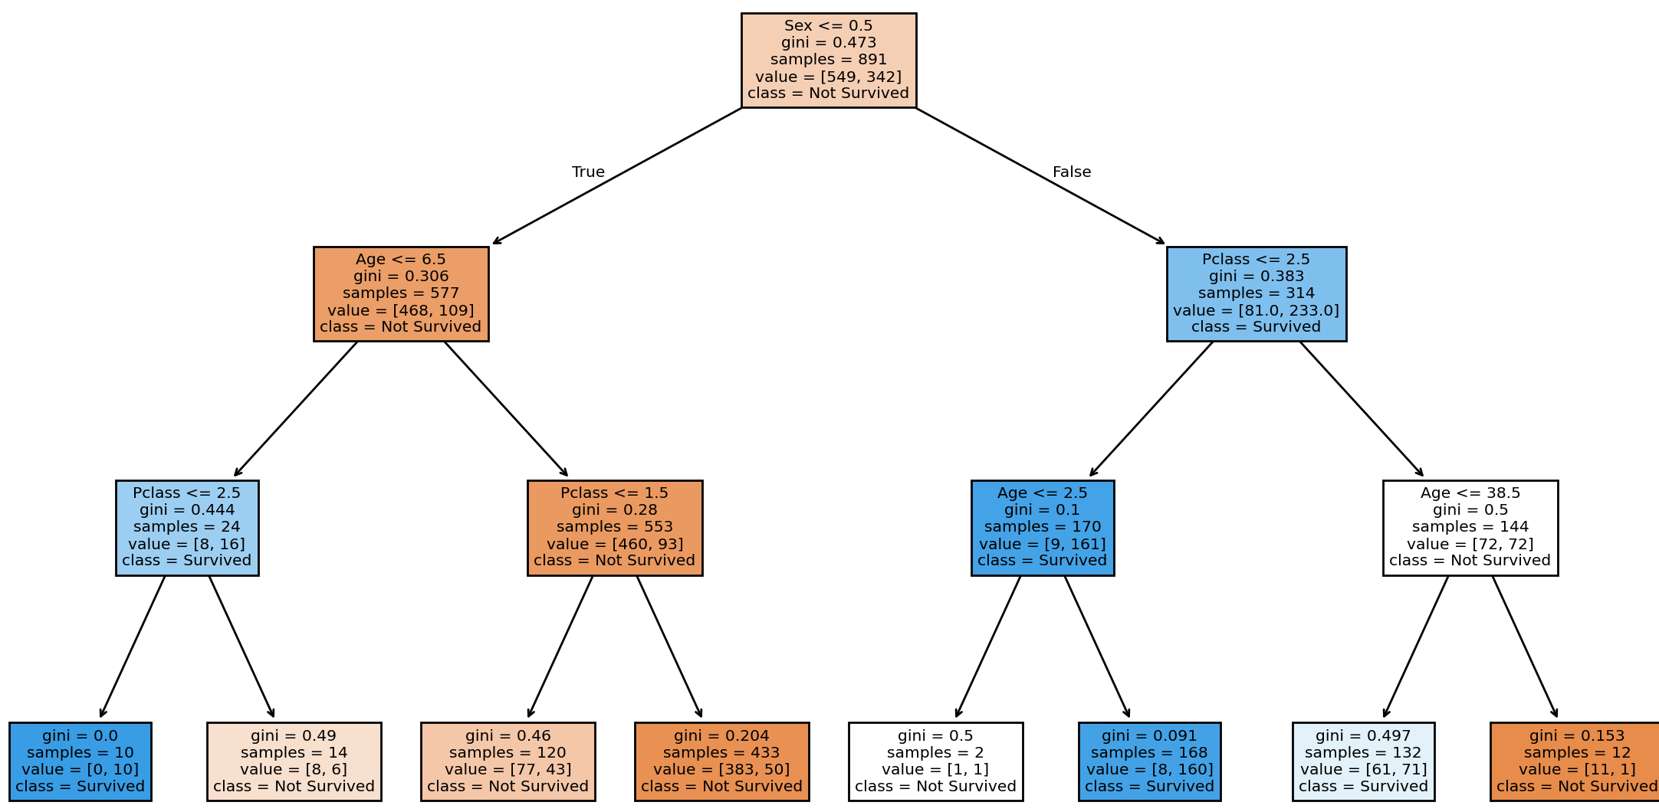

Slide 55
1.2.5🧠 Support Vector Machine
A Support Vector Machine (SVM) is a powerful supervised learning algorithm used for classification and regression.
At its core, SVM tries to find the best boundary (hyperplane) that separates classes in your data.
It maximizes the margin between the closest points of each class (called support vectors).
It can handle non-linear boundaries using kernel tricks (like RBF, polynomial).
Imagine you're drawing a line to separate apples from oranges on a table.
SVM finds the line that gives the widest possible gap between the two groups — not just any line, but the most confident one.

Slide 56
Key Concepts of SVM
Hyperplane: SVM aims to find the best decision boundary (hyperplane) that separates different classes in the dataset. This hyperplane maximizes the margin between the closest data points of each class.
Support Vectors: These are the data points closest to the hyperplane. They are critical in defining the position and orientation of the hyperplane.
Margin: The margin is the distance between the hyperplane and the nearest data points from each class. SVM maximizes this margin to improve classification accuracy.
Kernel Trick: SVM uses kernel functions to transform non-linearly separable data into a higher-dimensional space where it becomes linearly separable. Common kernels include:
Linear Kernel
Polynomial Kernel
Radial Basis Function (RBF) Kernel
Sigmoid Kernel

Slide 57
Advantages & Disadvantages
Advantages
Works well for both linear and non-linear data.
Effective in high-dimensional spaces.
Robust against overfitting, especially in cases where the number of dimensions exceeds the number of samples.
Disadvantages
Computationally expensive for large datasets.
Requires careful tuning of hyperparameters (e.g., kernel type, regularization parameter).

Slide 58
Applications
Text Classification: Spam detection, sentiment analysis.
Image Recognition: Handwriting recognition, facial recognition.
Bioinformatics: Protein classification, gene expression analysis.
SVM is a powerful tool, but its performance heavily depends on the choice of kernel and parameter tuning.

Slide 59
Regression vs Classification
Feature | SVM (Classification) | Regression (Prediction)
Goal | Separate categories | Predict a continuous value
Output | +1 or -1 (apple or orange) | Any number (e.g., sweetness = 7.5)
Line type | Separates groups with margin | Fits through points to minimize error
Data label type | Categorical (e.g., apple/orange) | Numerical (e.g., sweetness score)
Example question | “Is this fruit an apple or orange?” | “How sweet is this fruit?”
Visualization | Fence between groups | Trend line through points
VM is like sorting toys into bins: “This goes here, that goes there.”
Regression is like guessing someone’s height based on their age: “You’re probably 140 cm.”

Slide 60
🍎 Step 0: The Starting Data — Meet the Fruits
Imagine we’re trying to teach a robot how to tell apples from oranges using just their size and color.
We begin with a simple table of fruits.
Each fruit has two features: Size and Color Value (let’s say red = 1, orange = 0).
We also give each fruit a label: +1 for apple, -1 for orange.
Fruit | Size | Color | Label
A | 3 | 1 | +1 (Apple)
B | 4 | 1 | +1 (Apple)
C | 2 | 0 | -1 (Orange)
D | 1 | 0 | -1 (Orange)
🧠 What’s happening? We’re giving the robot a few examples to learn from. It doesn’t know what an apple or orange is yet — it just sees numbers.

Slide 61
✂️ Step 1: Trying to Draw a Line
Now we ask: “Can you draw a line that separates apples from oranges?”
This line is called a hyperplane. In 2D, it’s just a straight line.
We don’t change the data yet, but we start thinking about how each fruit relates to the line:
Fruit | Size | Color | Label | Rule to Follow
A | 3 | 1 | +1 | Must be on one side of the line
B | 4 | 1 | +1 | Same side as A
C | 2 | 0 | -1 | Must be on the other side
D | 1 | 0 | -1 | Same side as C
🧠 What’s happening? We’re telling the robot: “Put apples on one side, oranges on the other.”

Slide 62
🧮 Step 2: Finding the Best Line (Maximum Margin)
Now the robot tries different lines and picks the one that gives the biggest gap between apples and oranges — this is the “maximum margin.”
We now calculate how far each fruit is from the line. The ones closest to the line are called support vectors.
Fruit | Size | Color | Label | Distance from Line | Support Vector?
A | 3 | 1 | +1 | 1.2 | ✅
B | 4 | 1 | +1 | 2.0 | ❌
C | 2 | 0 | -1 | 1.0 | ✅
D | 1 | 0 | -1 | 2.0 | ❌
🧠 What’s happening? The robot finds the fruits that are closest to the boundary — these are the most “important” for drawing the line.

Slide 63
🧠 Step 3: Learning the Rule
Now the robot writes down the rule it learned: 𝑓(𝑥)=𝑤₁⋅ Size+ 𝑤₂⋅Color+𝑏
Let’s say it finds: 𝑓(𝑥)=1.0⋅Size+0.5⋅Color−3
We now use this rule to predict new fruits.
🔮 Step 4: Predicting New Fruits
Let’s test the robot with new fruits:
Fruit | Size | Color | f(x) | Prediction
E | 3 | 1 | 1.0×3 + 0.5×1 - 3 = 1.5 | Apple (+1)
F | 1 | 0 | 1.0×1 + 0.5×0 - 3 = -2.0 | Orange (-1)
🧠 What’s happening? The robot now uses math to decide: “If f(x) is positive, it’s an apple. If negative, it’s an orange.”

Slide 64
🎓 Final Summary
We start with labeled examples.
We try to draw a line that separates the two groups.
We find the best line — the one with the biggest gap.
We learn the rule from the line.
We use the rule to predict new things.
It’s like teaching a robot to play “Guess the Fruit” using math and examples.

Slide 65
“07_SVM_Noddy.py” SVM classifier
import numpy as np
# 🎲 Step 1: Create synthetic fruit data
# Feature 1: Size, Feature 2: Color (1 = red, 0 = orange)
X = np.array([[3, 1], [4, 1], [2, 0], [1, 0], [3.5, 1], [1.5, 0], [2,2]])
y_class = np.array([1, 1, -1, -1, 1, -1,-1]) # SVM labels: Apple (+1), Orange (-1)
# 🔍 Step 2: Scale features
from sklearn.preprocessing import StandardScaler
scaler = StandardScaler()
#Transformed data with a mean of 0 and a standard deviation of 1.
X_scaled = scaler.fit_transform(X)
# 🔪 Step 3: Train-test split
from sklearn.model_selection import train_test_split
X_train, X_test, y_class_train, y_class_test = train_test_split(X_scaled, y_class, test_size=0.3, random_state=42)
# 🧠 Step 4: Train models
from sklearn.svm import SVC
svm_model = SVC(kernel='linear')
svm_model.fit(X_train, y_class_train)

Slide 66
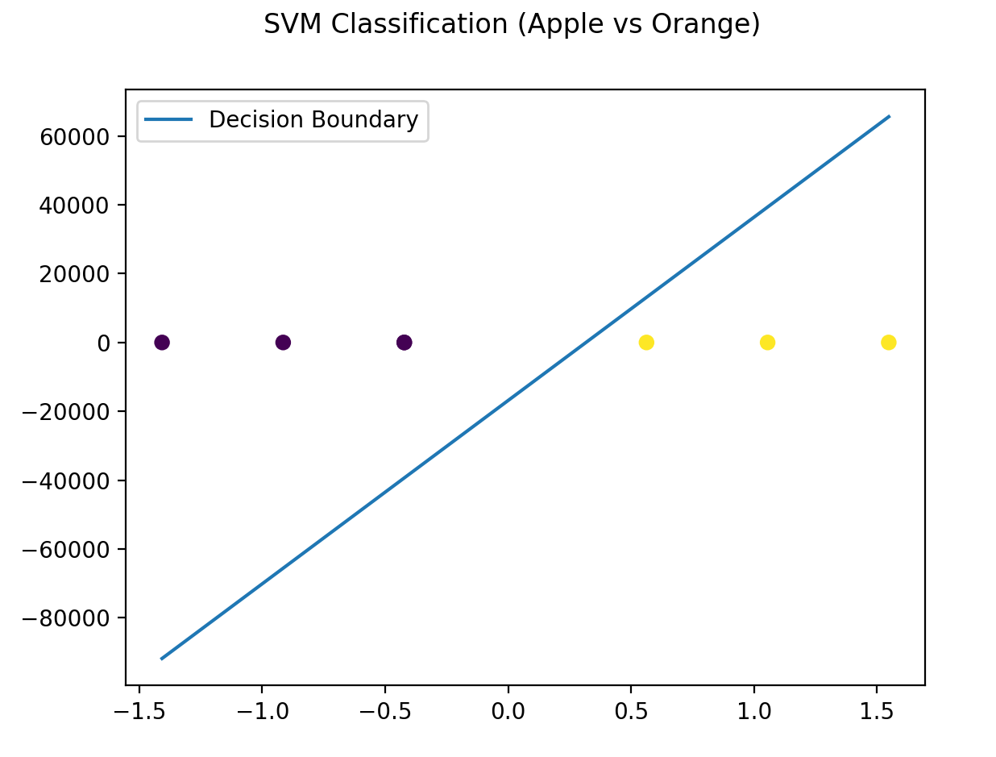
# 🎨 Step 5: Plotting
import matplotlib.pyplot as plt
# SVM Plot
plt.suptitle("SVM Classification (Apple vs Orange)")
# first feature, second feature, color by class label
# The labels (y_class) are not coordinates,
# they’re used to color the points to show which class they belong to.
plt.scatter(X_scaled[:, 0], X_scaled[:, 1], c=y_class)
# Decision boundary
# 𝑤0 𝑥 + 𝑤1 𝑦 + 𝑏=0
w = svm_model.coef_[0] #w is the weight vector [w0, w1]
b = svm_model.intercept_[0] #b is the bias/intercept term
# This creates 100 evenly spaced x-values across the range of the first feature.
x_vals = np.linspace(X_scaled[:, 0].min(), X_scaled[:, 0].max(), 100)
# This is the key step: solving the decision boundary equation for y.
y_vals = -(w[0] * x_vals + b) / w[1] # 𝑦 = (0- 𝑤0 𝑥 - 𝑏) / 𝑤1
plt.plot(x_vals, y_vals, label='Decision Boundary')
plt.legend()
plt.show()

Slide 67
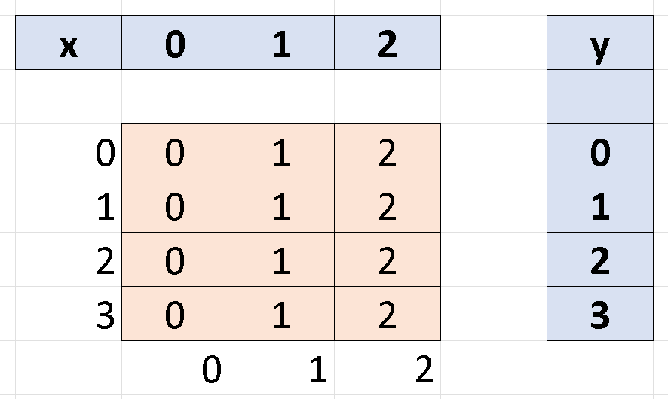
📏 np.linspace() & 🧮 np.meshgrid()
🔍 What It Does:
Generates evenly spaced numbers over a specified interval.
🧪 Syntax:
np.linspace(start, stop, num)
start: beginning of the interval
stop: end of the interval
num: number of points to generate
📊 Example:
np.linspace(0, 10, 5)
🔢 Output: array([ 0., 2.5, 5., 7.5, 10.])
This creates 5 evenly spaced values between 0 and 10.
🧠 Use Case:
Perfect for plotting smooth curves or setting up axes for decision boundaries.
🔍 What It Does:
Creates a grid of coordinate pairs from two 1D arrays - used to evaluate functions over a 2D space.
📊 Example:
x = np.linspace(0, 2, 3) # [0.0, 1.0, 2.0]
y = np.linspace(0, 3, 4) # [0.0, 1.0, 2.0, 3.0]
xx, yy = np.meshgrid(x, y)
🔢 Output:
xx = yy =
[[0. 1. 2.] [[0. 0. 0.]
[0. 1. 2.] [1. 1. 1.]
[0. 1. 2.] [2. 2. 2.]
[0. 1. 2.]] [3. 3. 3.]]
🧠 Use Case:
Used to evaluate a function like f(x, y) over a grid

Slide 68
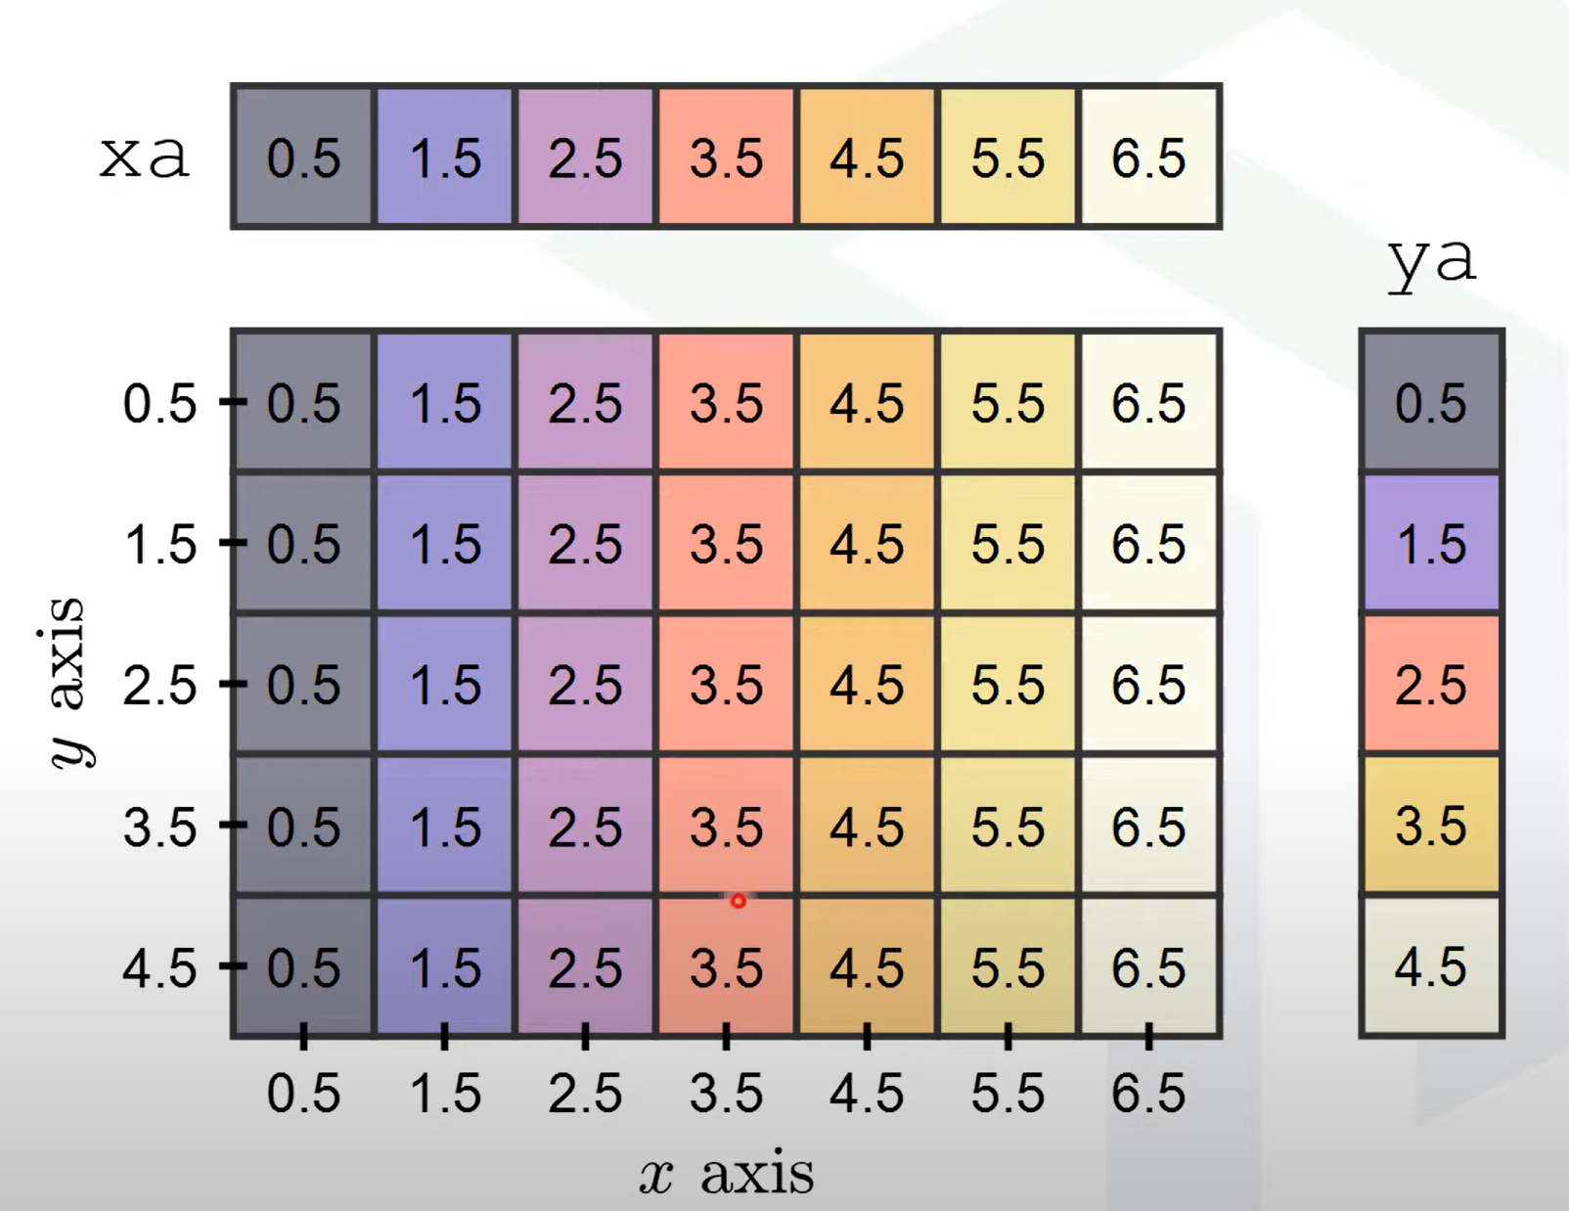
Function | Purpose | Common Use Case
np.linspace() | Create evenly spaced values | Smooth plots, axis setup
np.meshgrid() | Create 2D grid from 1D arrays | Decision boundaries, heatmaps

Slide 69
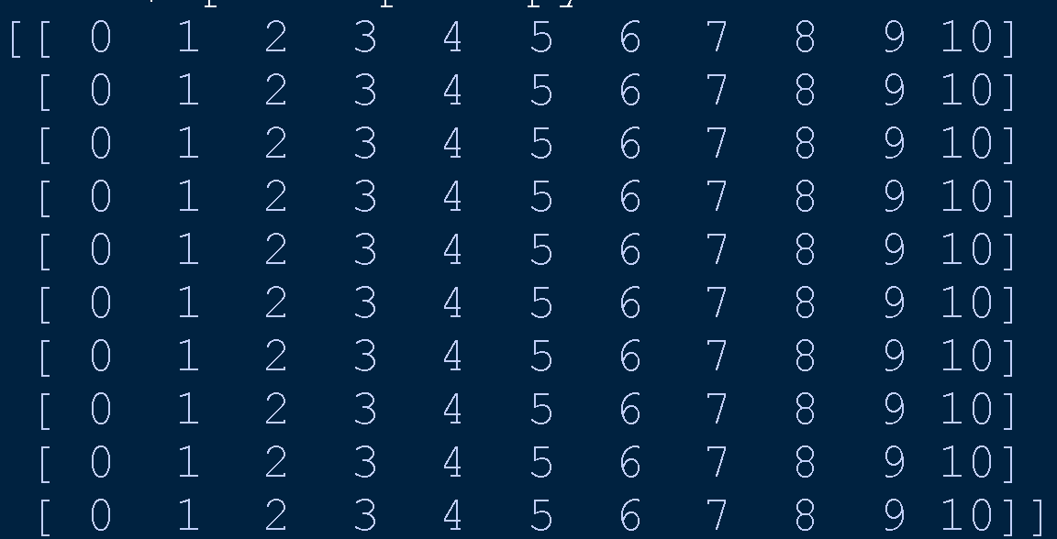
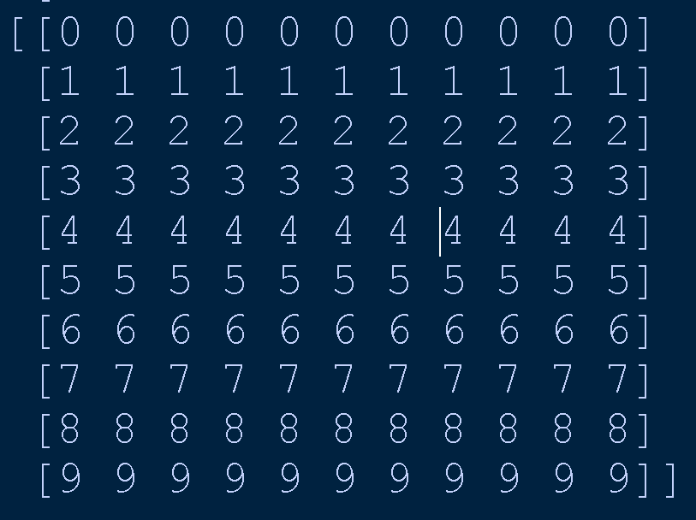
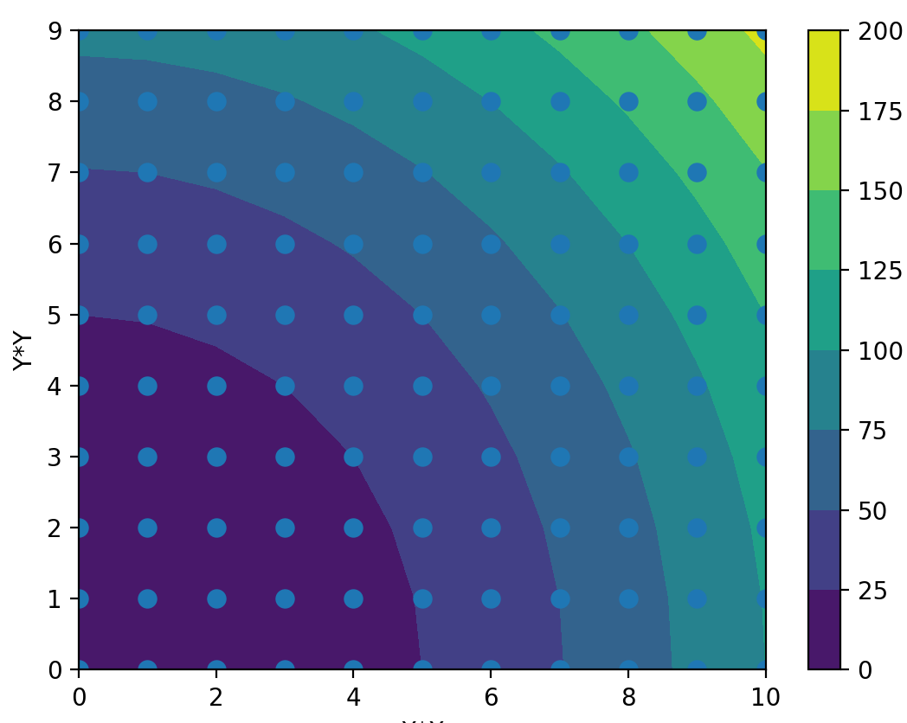
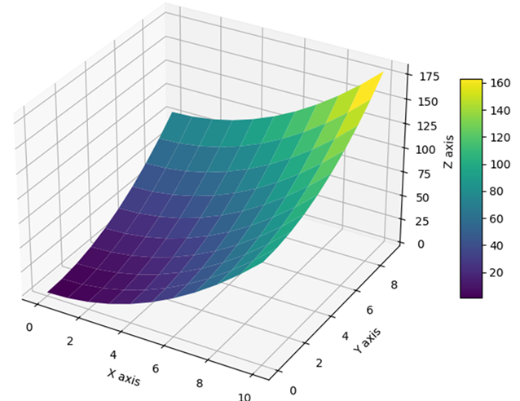
Meshgrid and contour
contour function draws only contour lines.
contourf fills the regions between contour lines with colors, providing a visual representation of how a 2D scalar field changes across a surface.
contourf is a function from the matplotlib.pyplot module, to create filled contour plots.

Slide 70
Meshgrid: python
import numpy as np
# Define x and y ranges
x = np.array([0,1,2,3,4,5,6,7,8,9,10])
y = np.array([0,1,2,3,4,5,6,7,8,9])
# Create meshgrid
X, Y = np.meshgrid(x, y)
print(X)
print(Y)
# Evaluate function at each grid point
Z = X*X + Y*Y # Elevation = x + y
# Plot
import matplotlib.pyplot as plt
plt.contourf(X, Y, Z)
plt.colorbar()
plt.scatter(X, Y, s=50)
plt.xlabel("X*X")
plt.ylabel("Y*Y")
#plt.grid(True)
plt.show()

Slide 71
SVM classification with titanic dataset

Slide 72
import pandas as pd
import numpy as np
# 📥 Step 1: Load and Preprocess Titanic Data
#url = "https://raw.githubusercontent.com/datasciencedojo/datasets/master/titanic.csv"
url="titanic.csv"
df = pd.read_csv(url)
# 🧼 Preprocess
from sklearn.preprocessing import LabelEncoder
df = df[['Survived', 'Pclass', 'Sex', 'Age', 'Fare']].dropna()
df['Sex'] = LabelEncoder().fit_transform(df['Sex'])
# Step 2. Feature Matrix and Target
X = df[['Pclass', 'Sex', 'Age', 'Fare']]
y = df['Survived']
# 🔍Step 3. Standardize Features: Scale features
# This is crucial for SVM performance.
from sklearn.preprocessing import StandardScaler
X_scaled = StandardScaler().fit_transform(X)

Slide 73
# 🔪Step 4. Train-Test Split
from sklearn.model_selection import train_test_split
X_train, X_test, y_train, y_test = train_test_split(X_scaled, y, test_size=0.3, random_state=42)
# 📉 Step 5. PCA to Reduce 4D to 2D for visualization
from sklearn.decomposition import PCA
pca = PCA(n_components=2)
X_train_pca = pca.fit_transform(X_train)
X_test_pca = pca.transform(X_test)

Slide 74
# 🧠 Step 6. Train SVM Models with Different Kernels
kernels = ['linear', 'poly', 'rbf','sigmoid']
models = {}
predictions = {}
accuracies = {}
from sklearn.svm import SVC
from sklearn.metrics import accuracy_score
for kernel in kernels:
if kernel == 'poly':
model = SVC(kernel=kernel, degree=3)
elif kernel == 'sigmoid':
model = SVC(kernel=kernel, gamma=0.1, coef0=0.5)
else:
model = SVC(kernel=kernel)
model.fit(X_train_pca, y_train)
y_pred = model.predict(X_test_pca)
#Stores the values wrt the dictionary keys
models[kernel] = model
predictions[kernel] = y_pred
accuracies[kernel] = accuracy_score(y_test, y_pred)

Slide 75
# 🎨 Step 7. Plot Decision Boundaries
import matplotlib.pyplot as plt
fig, axes = plt.subplots(1, 4, figsize=(18, 5))
# grabs the first principal component, lowest and highest values
x_min, x_max = X_train_pca[:, 0].min() - 1, X_train_pca[:, 0].max() + 1
y_min, y_max = X_train_pca[:, 1].min() - 1, X_train_pca[:, 1].max() + 1
xx, yy = np.meshgrid(np.linspace(x_min, x_max, 300),
np.linspace(y_min, y_max, 300))
for i, kernel in enumerate(kernels):
# SVM model to 'predict' the class (0 or 1) for each grid point.
# a grid of predicted class labels over the entire feature space.
Z = models[kernel].predict(np.c_[xx.ravel(), yy.ravel()]).reshape(xx.shape)
# Plot Decision Boundary
axes[i].contourf(xx, yy, Z, alpha=0.3, cmap='coolwarm')
# Plot Test Points
axes[i].scatter(X_test_pca[:, 0], X_test_pca[:, 1], c=y_test, cmap='coolwarm', edgecolor='k')
axes[i].set_title(f"SVM ({kernel} kernel)\nAccuracy: {accuracies[kernel]:.2f}")
plt.tight_layout()
plt.show()

Slide 76
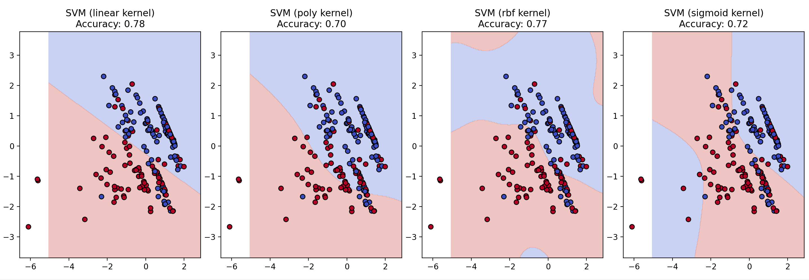
Output: classification with SVM

Slide 78
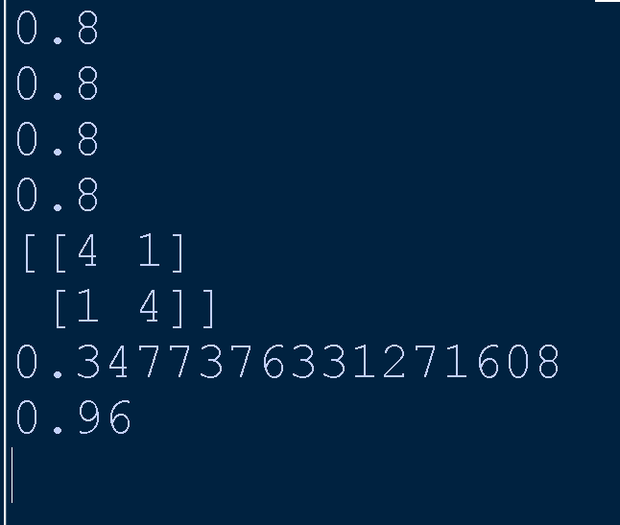
Evaluate Model Performance
from sklearn.metrics import accuracy_score, log_loss, roc_auc_score, precision_score, recall_score, f1_score, confusion_matrix
y_true = [1, 0, 1, 1, 0, 0, 1, 0, 1, 0] # True labels
y_pred = [1, 0, 1, 0, 0, 0, 1, 1, 1, 0] # Predicted labels
# Predicted probabilities (for log loss and AUC)
y_proba = [0.9, 0.2, 0.8, 0.4, 0.3, 0.1, 0.7, 0.6, 0.95, 0.2]
# 1. (Overall correctness)Fraction of correct predictions.
print(accuracy_score(y_true, y_pred))
# 2. (Quality of positive predictions) Of all predicted positives,
# how many were actually positive? Formula: TP / (TP + FP)
print(precision_score(y_true, y_pred))
# 3. (Coverage of actual positives) Of all actual positives,
# how many did we correctly predict? Formula: TP / (TP + FN)
print(recall_score(y_true, y_pred))
# 4. (Balance of precision & recall)Harmonic mean of precision and recall.
# Example: F1 = 2 * (Precision * Recall) / (Precision + Recall)
print(f1_score(y_true, y_pred))
# 5. (Breakdown of prediction outcomes)# Breakdown of prediction outcomes: TN, FP, FN, TP
print(confusion_matrix(y_true, y_pred))
# 6. (Confidence penalty)
print(log_loss(y_true, y_proba))
# 7. (Class separation)Measures how well model separates classes#0.5(random) to 1 (perfect).
print(roc_auc_score(y_true, y_proba))

Slide 79
Evaluate Model Performance
📊 1. Accuracy: accuracy_score(y_true, y_pred)
Definition: Fraction of correct predictions.
Example: 8 out of 10 predictions are correct → Accuracy = 0.8
Limitation: Doesn’t account for class imbalance.
📉 2. Logarithmic Loss (Log Loss): log_loss(y_true, y_proba)
Definition: Penalizes confident wrong predictions more than less confident ones.
Example: Predicting 0.99 for class 0 is worse than predicting 0.6.
Lower is better: A perfect model has log loss near 0.
📈 3. Area Under Curve (AUC - ROC): roc_auc_score(y_true, y_proba)
Definition: Measures how well the model separates classes.
Range: 0.5 (random) to 1.0 (perfect).
Example: AUC of 0.92 means strong separation between positive and negative classes.

Slide 80
🎯 4. Precision: precision_score(y_true, y_pred)
Definition: Of all predicted positives, how many were actually positive?
Formula: TP / (TP + FP)
Example: If 5 predicted positives, and 4 are correct → Precision = 0.8
🔍 5. Recall (Sensitivity): recall_score(y_true, y_pred)
Definition: Of all actual positives, how many did we correctly predict?
Formula: TP / (TP + FN)
Example: If 6 actual positives, and 5 are correctly predicted → Recall = 0.83
⚖️ 6. F1 Score: f1_score(y_true, y_pred)
Definition: Harmonic mean of precision and recall.
Use Case: Balances false positives and false negatives.
Example: F1 = 2 * (Precision * Recall) / (Precision + Recall)
🧮 7. Confusion Matrix: confusion_matrix(y_true, y_pred)
Breakdown of prediction outcomes

Slide 82
Example Dataset (2D Binary Classification)
Point | x₁ | x₂ | Label (y)
A | 2 | 2 | +1
B | 4 | 4 | +1
C | 4 | 0 | -1
D | 0 | 0 | -1
✏️ Step 1: Define the Hyperplane:
A hyperplane in 2D is: w₁x₁ + w₂x₂ + b = 0 ; Where:
𝑤 = [ 𝑤₁ , 𝑤₂ ] is the weight vector
𝑏 is the bias
The decision rule is: Predict 𝑦 = sign ( 𝑤^{𝑇} 𝑥 + 𝑏 )
We want to find a line (hyperplane) that separates the +1 and -1 classes.

Slide 83
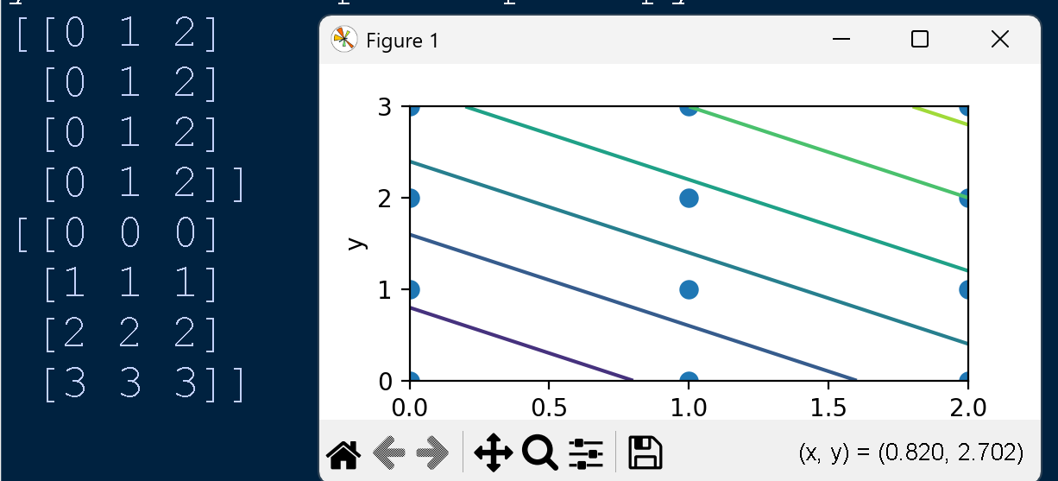
Meshgrid example

